Slide 1
Open access and the next REF
Steven Hill
Royal Holloway
22 October 2014
@stevenhill #OAREF

Slide 2
Publicly funded research should be freely open to the public that paid for it.

Slide 3
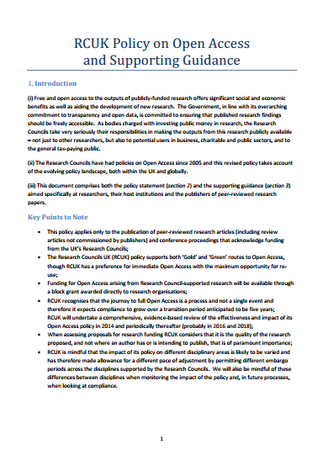
The policy context

Slide 4
And now the REF
Open research is excellent research
Mandates are successful
£2 billion

Slide 5
Our aims
Repositories are a tried and tested route to OA, a significant investment, and a national asset
Author engagement must increase
We must set reasonable and achievable goals, with flexibility (exceptions)
We must set clear and straightforward rules

Slide 6
Outputs submitted to a post-2014 REF should be “open access”.
The core principle of the policy

Slide 7
Minimum requirements
Extra credit
http://openclipart.org/image/300px/svg_to_png/8299/Gerald_G_Baseball_bat.png, http://openclipart.org/detail/6216/carrot-by-trnsltlife
Notes:
Two-tier approach – the carrot and the stick.

Slide 8
The minimum requirements
To be eligible for the next REF, journal articles and conference papers accepted after 1 April 2016 must be:
Deposited in a repository as the peer-reviewed manuscript (or better)
Made accessible for read and download after 12 months or 24 months

Slide 9
Maximum embargoes
http://en.wikipedia.org/wiki/File:2010-07-20_Black_windup_alarm_clock_face.jpg
REF main panels A and B:
12 months
REF main panels C and D:
24 months

Slide 10
Will publishers allow authors to deposit their papers in repositories?
Yes!

Slide 11
How many journal articles are published in venues with permissible embargoes?
96%

Slide 12
How many papers are being deposited today?
12%

Slide 13
Extra credit
Environment component of the REF can drive innovation and deeper, lasting change
Benefits of OA should be extended beyond journals and conferences
“© All Rights Reserved” is no basis for libre open access

Slide 14
Extra credit
Reuse and text-mining (libre OA)
Outputs not in scope (books etc.)

Slide 15
Challenges for institutions
Complex mixture of policies
Compliance and culture change
Technical challenges
Cost issues for gold OA
Long-term trajectory for UK OA

Slide 16
Challenges for policymakers
Implementation and monitoring
Stability vs. harmony
Acceptability of embargoed, double-dipped, and gratis OA
Long-term trajectory for UK OA: seizing the golden opportunity?

Slide 17
Some further work
Funder-publisher-institution coordination and monitoring
FAQs, further information, review
Technical implementation (Jisc, publishers, funders)
Monographs and OA Project
Open Data

Slide 18
Thomas Jefferson
He who receives an idea from me, receives instruction himself without lessening mine; as he who lights his taper at mine, receives light without darkening me.

Slide 19
Thank you for listening
s.hill@hefce.ac.uk
@stevenhill
openaccess@hefce.ac.uk

